Slide 1
Zika Virus
Maria Petrova; 8g; Fac № 11800
Faculty of Pharmacy

Slide 2
CONTENTS OF THIS PRESENTATION
Epidemiologic Features
Transmission
Clinical Manifestations
Diagnosis
Treatment and Prevention

Slide 3
Epidemiologic Features
ZIKV is a positive-sense RNA flavivirus in the family Flaviviridae.
ZIKV was first isolated in 1947 in the Zika Forest in Uganda.
ZIKV migrated to Asia.
The ZIKV pandemic was an example of a “perfect storm”.

Slide 4
Transmission
Mosquito-borne transmission;
Blood transfusion;
During sexual contact;
Maternal–fetal transmission.

Slide 5
Clinical Manifestations
The majority (50 to 80%) of ZIKV infections are asymptomatic.
Symptomatic ZIKV infection manifests as a rash, low-grade fever, arthralgia and myalgia, and conjunctivitis.
Complications are severe and may be fatal.
The striking feature of the clinical manifestation is the neurologic complications.

Slide 6
Diagnosis
Nucleic acid testing;
Serologic testing;
A positive nucleic acid test shows the presence of ZIKV RNA but does not necessarily indicate the presence of infectious virus.

Slide 7
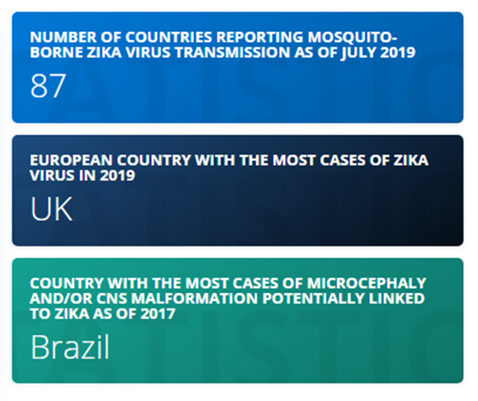
Treatment and Prevention
In vitro;
Supportive care;
Abstinence or protected sexual intercourse;
Avoidance of infection during pregnancy or postponement of pregnancy.

Slide 8
Conclusions — Lessons Learned from the Pandemic
The pandemic increased positive awareness about critical social justice issues.
The virus still poses a public health threat.
There is a critical need to mobilize support and improve capacity in low- and middle-income countries.

Slide 9
Thank you for your attention!

